Slide 1
Education system
Arfana Rahman
IS-12-20

Slide 2
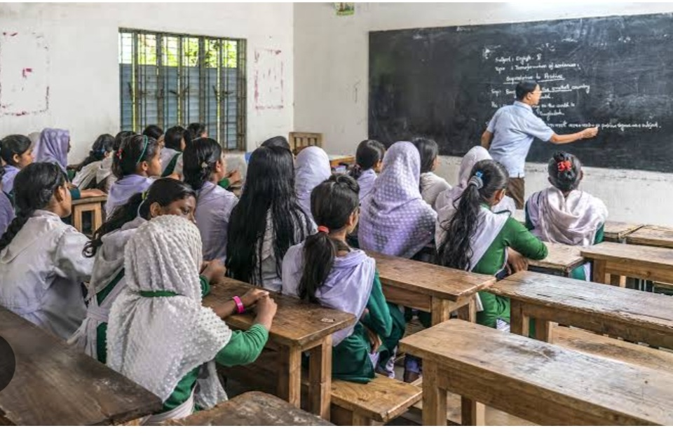
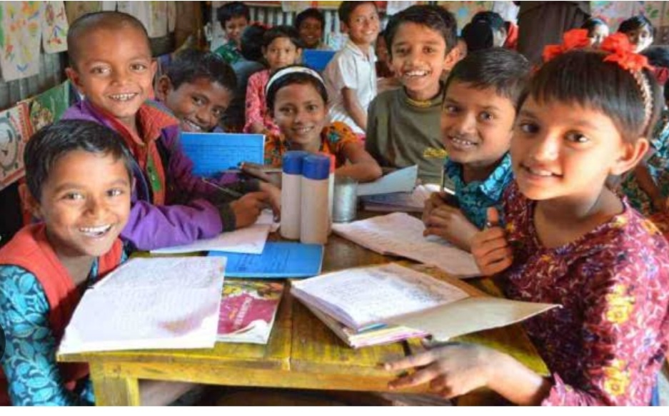
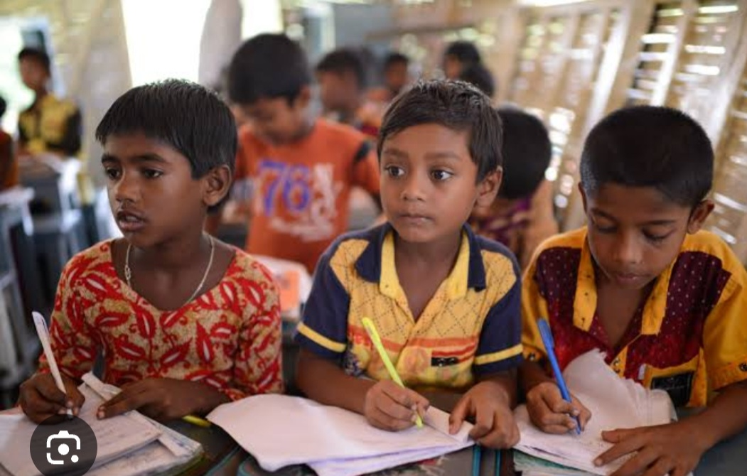

Slide 3
Outline of the presentation
Current status of education
Challenges
Recommendation
Social influence
Level of education

Slide 4
what is education system
The system which providing education through public and private institute is called education system

Slide 5
?
What is education system

Slide 6
Education system divided into three section
Primary education
Secondary education
Tertiary education

Slide 7
Junior secondary
Higher secondary
secondary

Slide 8
urban
rural

Slide 9
Comparison of rural and urban areas facilities
Rural area
Urban area
Poorer
Lower literacy
Little infrastructure
Lower facilities
Wealthier
Higher literacy
More developed infrastructure
Highy facilities

Slide 10
The number of education institution
There are 114,539 in government primary school
There are 20,960 secondary schools
There are 3,685 schools and collage
There are 170 universities ,of these 53 are public and 170 are private

Slide 11
There are three classification of education system
General
Technical &vocational
Madrasha

Slide 12
Problems of our education system
>Not enough institution
>Not enough efficient teacher
>low budget
>Dropout problem

Slide 13
HOW can education help us?
Education could provide a safe space for student during ,a crisis .give the much needed psychosocial support for development.as well as hope ,stability and a sense of security

Slide 14
Madrasha education system
Alia (govt)
Qawmi(non govt)
Qawmi education system is independent Islamic curriculum and it operate outside of government secular subject
Alia education system is combines Islamic and secular studies and regulated by the government

Slide 15
Possible solution
>more educational institute
>provide qualified teacher
>improve quality in education
>increase literacy rate condition
>reduce dropout rate

Slide 16
Secondary level
Management Bodies
Dhaka education board
Sylhet education board
Chittagong education board
Rajshahi education board
Jessore education board
Comilla education board
Barisal education board
Dinajpur education board
Mymensingh education board

Slide 17
Conclusion
Government must be modifying the system to give wonderful life for students
There is a role of education Institutional too to improve the method of teaching
A good education system Leads to a good society
Education is simple the soul of a good society as it passes from one generation to another.....

Slide 18
Here is a link form which you can know more details about education system
https://en.m.wikipedia.org/wiki/Education_in_Bangladesh

Slide 19
.
Have you any question?

Slide 20
Thank you

